Slide 1
Doorstep
SE Sprint 2
UM1
PM: Kayhan Kishi & Oluwanifemi Owolabi
SM: Hyunki Lee & Alexandra Ochoa
Programmers: David Martinez & Austin Do

Slide 2
Epics Completed
1) UML Sequence diagram
2) UML Use case diagram
3) UI/UX
4) PowerPoint

Slide 3
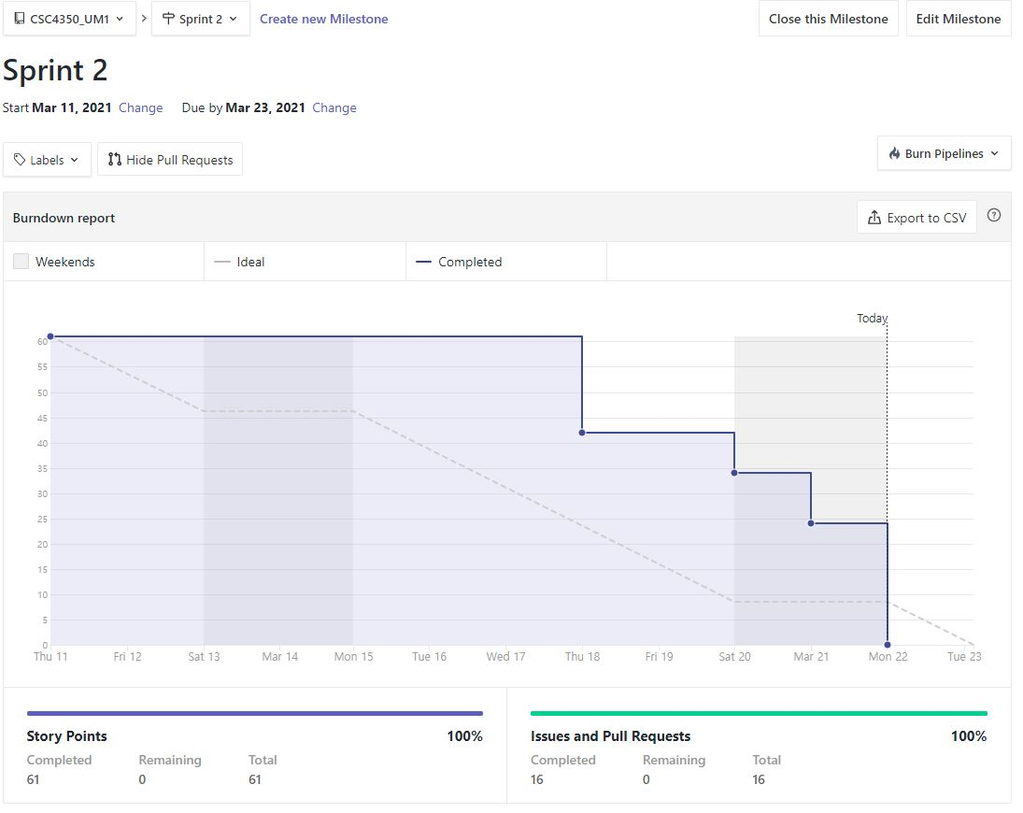
Burn down chart

Slide 4
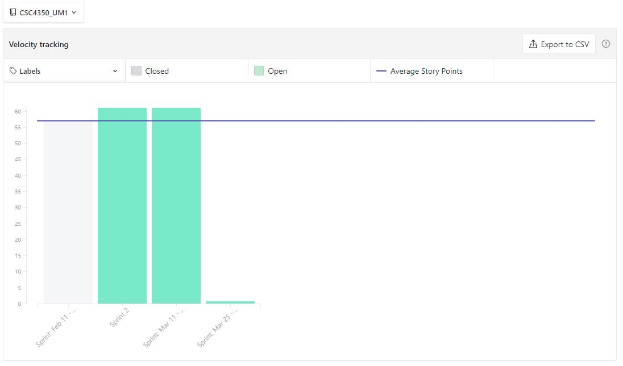
Velocity Chart
Notes:
Reference : https://help.zenhub.com/support/solutions/articles/43000010358-track-team-velocity-sprint-over-sprint

Slide 5
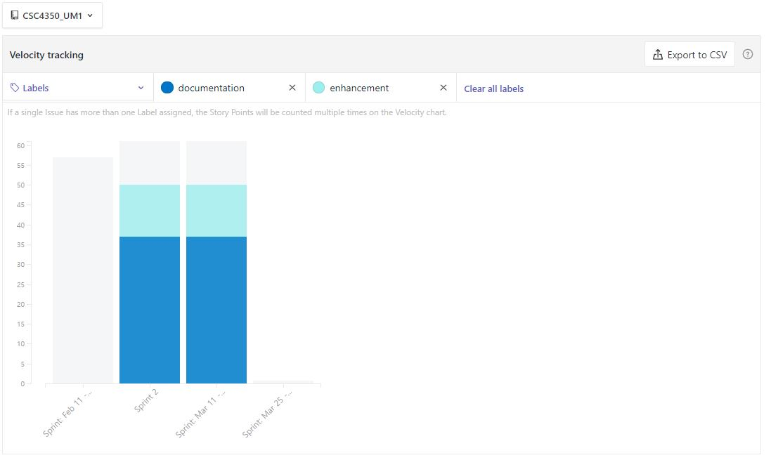
Velocity Chart
Notes:
Reference : https://help.zenhub.com/support/solutions/articles/43000010358-track-team-velocity-sprint-over-sprint

Slide 6
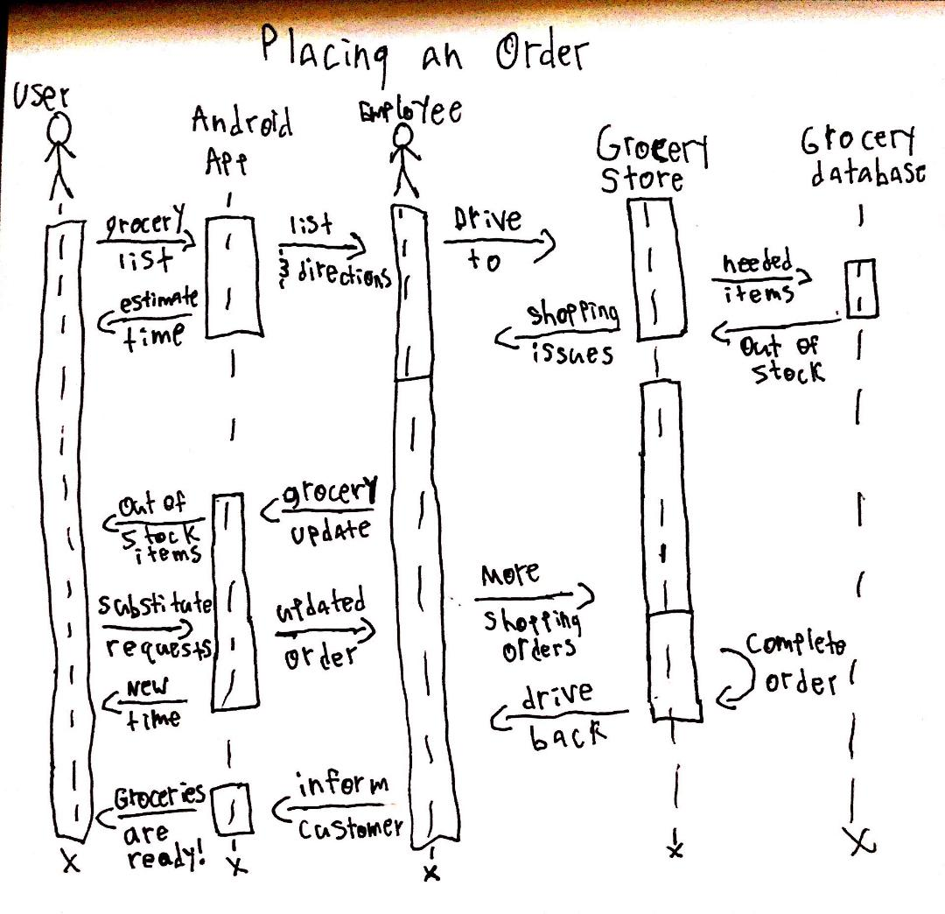
UML Sequence Diagrams - Placing Orders
The Sequence in which a grocery list is given from a customer and leads to their groceries ending up on their doorstep no matter the complications!

Slide 7
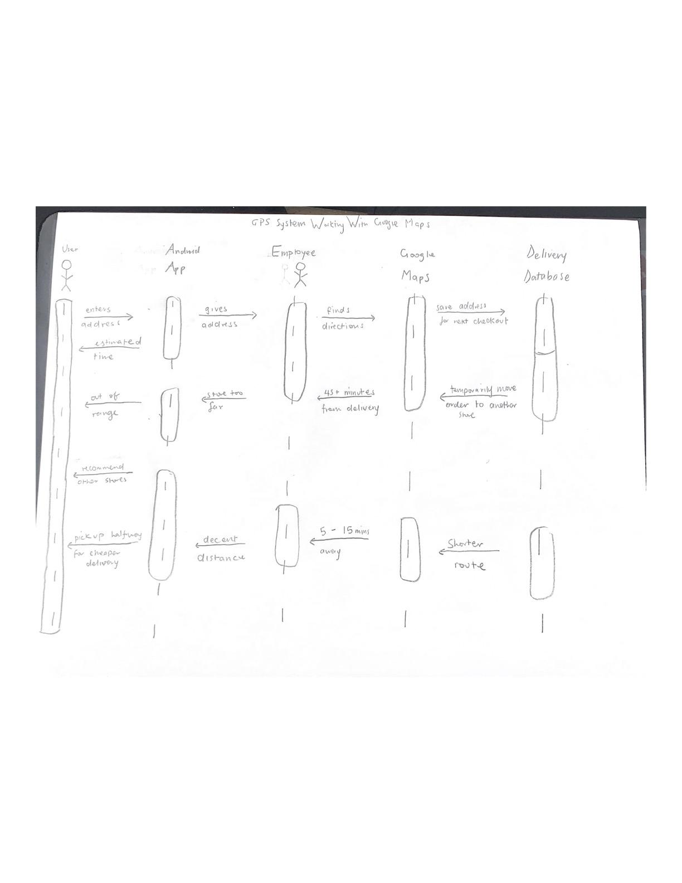
UML Sequence Diagrams - Delivery
The sequence for retrieving an estimated time for delivery and possible alternatives.

Slide 8
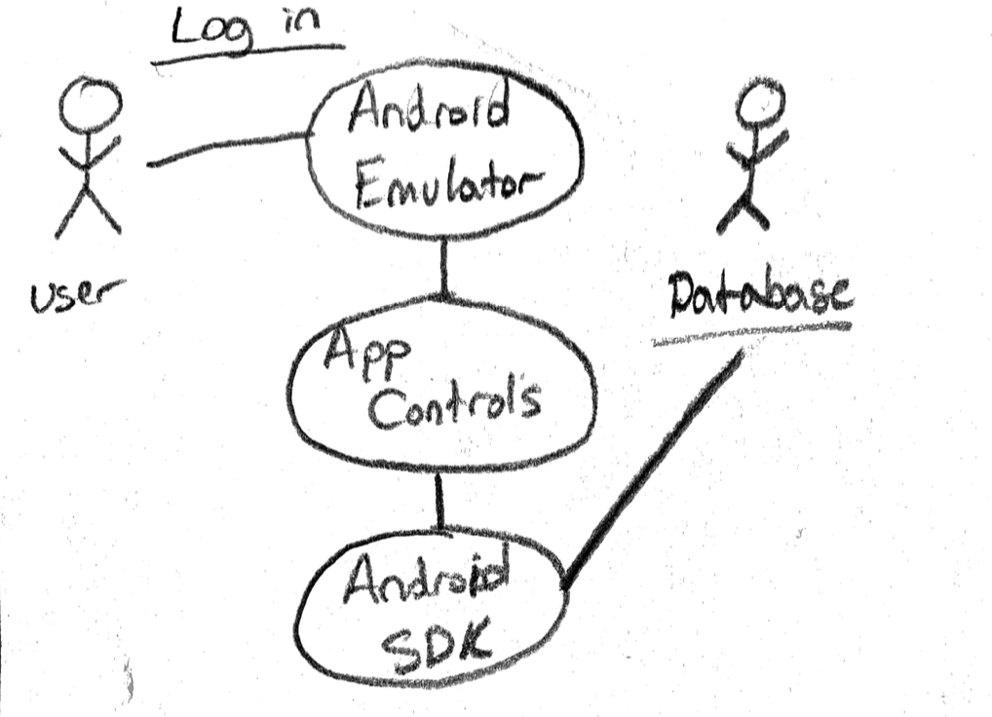
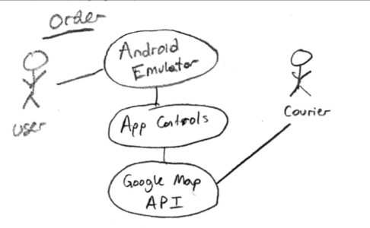
UML use case diagrams (Internal)

Slide 9
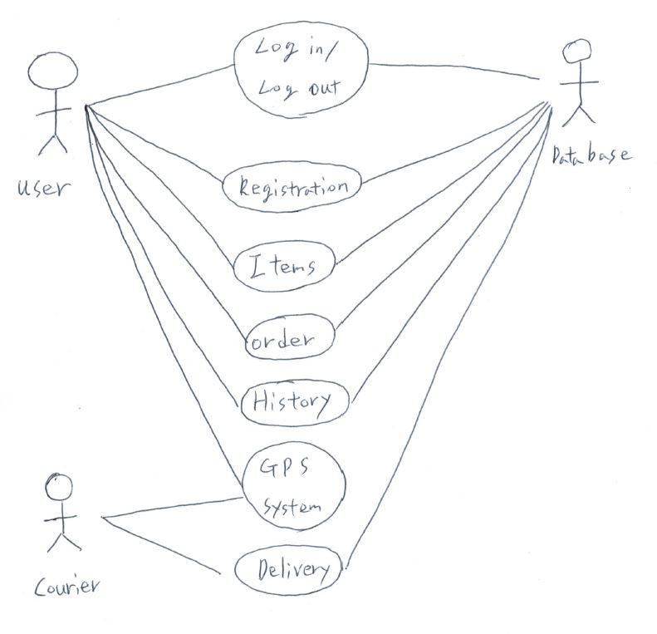
UML use case diagrams(External)

Slide 10
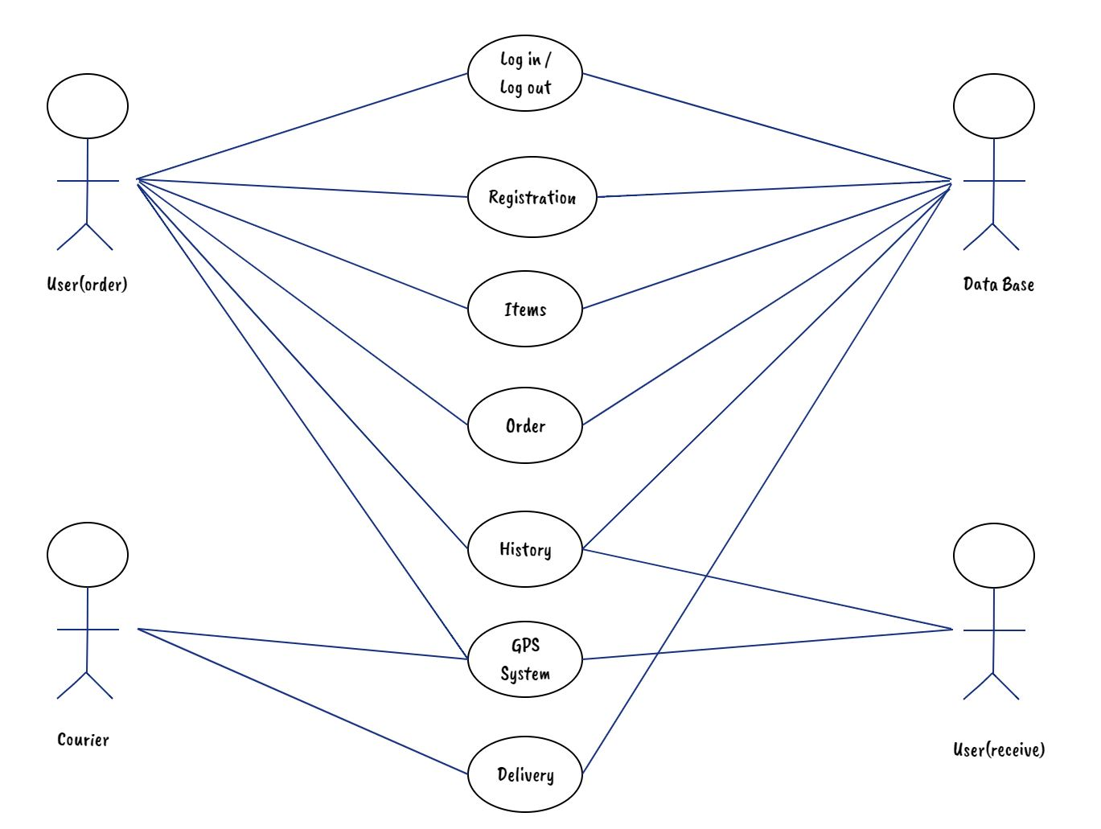
UML use case diagrams(External)

Slide 11
UI Prototype - SM

Slide 12
